Slide 1

APARTMENT VISITORS MANAGEMENT SYSTEM
MOHAMMED SHAHEEL KP
MES23MCA-2032
Department of Computer Applications
MES College of Engineering, Kuttippuram
04/10/2024

Slide 2
PRODUCT OWNER MR.VASUDEVAN T V ASSISTANT PROFESSOR DEPARTMENT OF COMPUTER APPLICATIONS MES COLLEGE OF ENGINEERING, KUTTIPPURAM

Slide 3
TABLE OF CONTENTS
Introduction
Objective
Motivation
Functionalities
Module Description
Developing Environment
Sprint Backlog
Product Backlog
User Story
Project Plans
Data Flow Diagrams
ER Diagram

Slide 4
APARTMENT VISITORS MANAGMENT SYSTEM
The Apartment Visitor System is designed to manage and monitor visitors entering residential complexes.
The system enhances security by keeping a detailed record of visitors while ensuring smooth and organized entry management.
The system includes a single module, Admin, which plays a central role in overseeing and controlling the visitor data.

Slide 5
APARTMENT VISITORS MANAGMENT SYSTEM
To develop a streamlined system that allows an admin to efficiently manage visitors entering the apartment complex, ensuring safety and ease of access for approved visitors.

Slide 6
OBJECTIVES
Enhanced security and monitoring.
Organized visitor management.
Easy access to visitor history and reports.
Improved communication between admin and residents.

Slide 7
MOTIVATIONS
Visitor Management: Streamline the process of registering and welcoming visitors, reducing wait times and administrative burdens.
Communication: Enhance communication between residents and the management office regarding visitor arrivals and departures.
Data Tracking: Collect and analyze data on visitor patterns to identify potential security risks or areas for improvement.

Slide 8
FUNCTIONALITIES
Visitor Registration:
Allow admin to manually register visitors.
Capture visitor information (name, contact details, purpose of visit).
Visitor Approval:
Provide admin with the ability to approve or deny visitor requests.
Implement a notification system to inform residents of approved or denied requests.

Slide 9
FUNCTIONALITIES
Visitor Tracking:
Track the entry and exit times of visitors.
Monitor visitor locations within the complex.

Slide 10
MODULE DESCRIPTION
1. Dashboard: In this sections, admin can briefly view how many visitors visited in a particular period.
Total visitors
Today's Visitor
Yesterday's Visitor
Last Seven day's Visitor
Total Pass Created
2. Visitors: In this section, admin adds new visitors by filling their information in add visitors sections and also view and manage visitor's records.

Slide 11
MODULE DESCRIPTION
Admin also put visitors out time in the manage records section.
3. Create Pass: In this section, admin can manage visitor pass (Create/View/Delete).
Create:Admin can create pass.. using visitor's name, address, category, mobile number
Print:Admin can also provide print out of pass with personal details and apartment details like Apartment no, Floor, From Date, To Date, Pass Description…..

Slide 12
MODULE DESCRIPTION
4. Search Visitor: In this bar, admin can search a particular person by their name and phone number.
5. Search Pass: In this bar, admin can search a particular visitor pass by their name and phone number.
6. Visitor Reports: In this section admin can generate visitor's reports between particular period
7. Pass Report: In this section, admin can generate visitor passes reports between particular period
8. admin can change login password,profile picture for future.

Slide 13
DEVELOPING ENVIRONMENT
OS : Windows 10
Frond-End : HTML,CSS &Java Script
Back-End : Python
Database: MySQL
IDE : VS Code
Framework : Django

Slide 14
SPRINT BACKLOG
Backlog tem | Status And Completion Date | Original Estimation in Hours | Day 1 hrs | Day 2 hrs | Day 3 hrs | Day 4 hrs | Day 5 hrs | Day 6 hrs | Day 7 hrs | Day 8 hrs | Day 9 hrs | Day 10 hrs
SPRINT1
Table designing | 16/8/2022 | 2 | 1 | 1 | 0 | 0 | 0 | 0 | 0 | 0 | 0 | 0
Form designing | 22/8/2022 | 3 | 1 | 1 | 1 | 0 | 0 | 0 | 0 | 0 | 0 | 0
Coding | 27/8/2022 | 3 | 1 | 1 | 1 | 0 | 0 | 0 | 0 | 0 | 0 | 0
SPRINT 2
Data collection | 13/9/2022 | 7 | 1 | 1 | 1 | 1 | 1 | 1 | 1 | 0 | 0 | 0
Data processing | 29/9/2022 | 7 | 1 | 1 | 1 | 1 | 1 | 1 | 1 | 0 | 0 | 0

Slide 15
SPRINT BACKLOG
Backlog tem | Status And Completion Date | Original Estimation in Hours | Day 1 hrs | Day 2 hrs | Day 3 hrs | Day 4 hrs | Day 5 hrs | Day 6 hrs | Day 7 hrs | Day 8 hrs | Day 9 hrs | Day 10 hrs
SPRINT3
Course contents | 3/10/2022 | 7 | 1 | 1 | 1 | 1 | 1 | 1 | 1 | 0 | 0 | 0
Assassement | 20/10/2022 | 7 | 1 | 1 | 1 | 1 | 1 | 1 | 1 | 0 | 0 | 0
SPRINT 4
Certificate | 8/11/2022 | 7 | 1 | 1 | 1 | 1 | 1 | 1 | 1 | 0 | 0 | 0
Testing | 15/11/2022 | 7 | 1 | 1 | 1 | 1 | 1 | 1 | 1 | 0 | 0 | 0
TOTAL |  | 50 | 9 | 9 | 8 | 6 | 6 | 6 | 6

Slide 16
PRODUCT BACKLOG
ID | NAME | PRIORITY <high/medium/low> | ESTIMATE (Hours) | STATUS <Planned/In progress/Completed>
1 | LOGIN | High | 5 | COMPLETED
2 | DASHBOARD | High | 10 | PLANNED
3 | CREATE PASS (create/view/ delete) | High | 10 | PLANNED
4 | VISITORS REPORT | MEDIUM | 10 | PLANNED
5 | PASS REPORTS | MEDIUM | 10 | PLANNED

Slide 17
USER STORY
User Story ID | As a type of User | I want to <Perform some task> | So that i can <Achieve Some Goal>
1 | ADMIN | Login | login successful with correct username and password
2 | ADMIN | View a summary of visitor activity over a specific period. | Quickly assess the level of visitor traffic and identify any unusual patterns.
3 | ADMIN | Add new visitors to the system and manage their records. | Track visitor information, including entry and exit times, and approve or deny visitor requests.
4 | ADMIN | Create, view, and delete visitor passes. | Control access to the apartment complex and ensure that only authorized visitors are allowed in.

Slide 18
USER STORY
User Story ID | As a type of User | I want to <Perform some task> | So that i can <Achieve Some Goal>
5 | ADMIN | Search for specific visitors or visitor passes by name or phone number. | Quickly locate visitor records when needed.
6 | ADMIN | Generate reports on visitor activity and visitor passes. | Analyze visitor data, identify trends, and make informed decisions about security measures.

Slide 19
PROJECT PLAN
User StoryID | Task Name | Start Date | End Date | Days | Status
1 | Sprint 1 | 16/08/2022 | 17/08/2022 | 10 | Completed
4 |  | 18/08/2022 | 19/08/2022 |  | Completed
5 |  | 20/08/2022 | 22/08/2022 |  | Completed
10 |  | 23/08/2022 | 24/08/2022 |  | Completed
11 |  | 25/08/2022 | 27/08/2022 |  | Completed
2 | Sprint 2 | 13/09/2022 | 23/09/2022 | 16 | Completed
7 |  | 23/09/2022 | 24/09/2022 |  | Completed
12 |  | 24/09/2022 | 29/09/2022 |  | Completed

Slide 20
PROJECT PLAN
User StoryID | Task Name | Start Date | End Date | Days | Status
3 | SPRINT 3 | 03/10/2022 | 06/10/2022 | 14 | Completed
6 |  | 07/10/2022 | 10/10/2022 |  | Completed
13 |  | 13/10/2022 | 20/10/2022 |  | Completed
14 | SPRINT 4 | 28/10/2022 | 5/11/2022 | 10 | Completed
8 |  | 7/11/2022 | 11/11/2022 |  | Completed
9 |  | 13/11/2022 | 15/11/2022 |  | Completed

Slide 21

DATA FLOW DIAGRAM
LEVEL 1

Slide 22
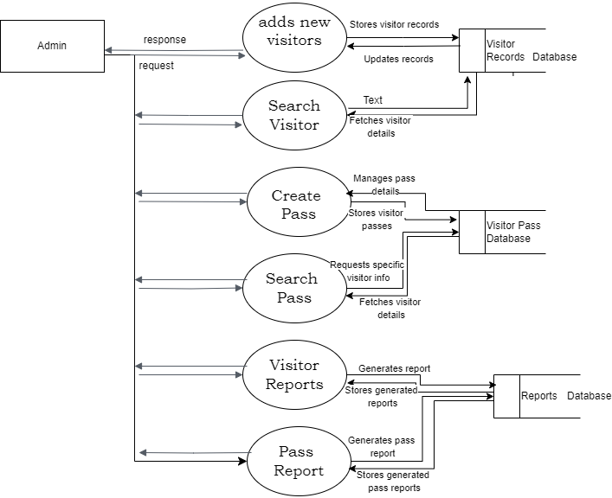
DATA FLOW DIAGRAM
Level 1.1

Slide 23
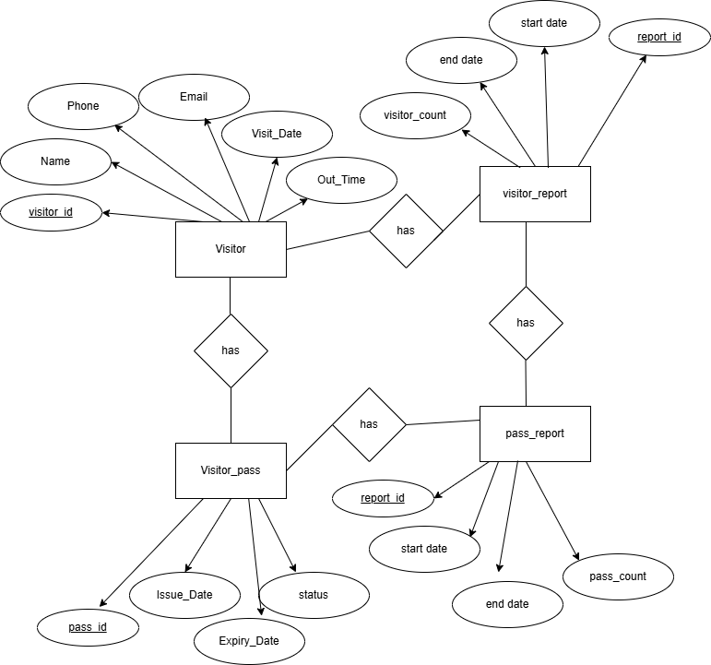
ER DIAGRAM

Slide 24
THANK YOU

